Slide 1
Introduction to OOP Course Title: Programming Language II Course Code: CSE 111 Semester: Summer 2020

Slide 2
Today’s Lecture
Concept of OOP
Pillars of OOP
Class
Object

Slide 3
Concept of OOP
Provides a means of structuring programs so that properties and behaviors are bundled into individual objects.
OOP reflects the real world behavior of how things work
It make visualization easier because it is closest to real world scenarios.
We can reuse the code through inheritance , this saves time, and shrinks our project.
There are flexibility through polymorphism

Slide 4
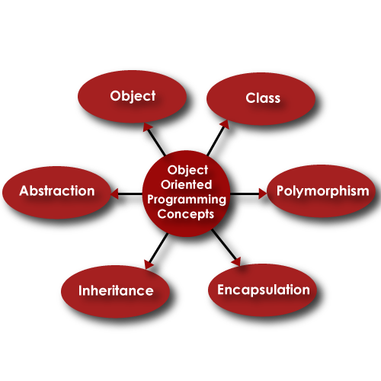
Pillars of OOP

Slide 5

Class
A class is the blueprint for the objects created from that class
Each class contains some data definitions(called fields), together with methods to manipulate that data
When the object is instantiated from the class, an instance variable is created for each field in the class
Template for making objects
Class

Slide 6
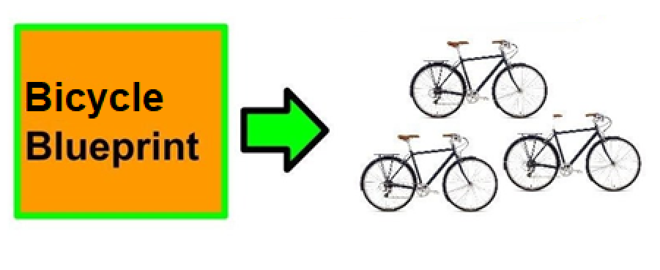
Object
Objects are the basic run time entities in an object oriented system
It is an instance of class
We can say that objects are the variables of the type class

Slide 7
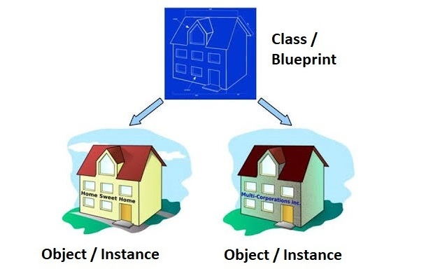
Class & Object

Slide 8

Class Components
Data (the attributes about it)
Behavior (the methods)
Data
Method()
driver_name
num_passenger
pick_up_passenger()
drop_off_passenger()

Slide 9
Method
A Python method is like a Python function
It must be called on an object.
It must put it inside a class
A method has a name, and may take parameters and have a return statement

Slide 10
Class Components
Taxi
driver_name: string
num_passenger: int
Pick_up_passenger()
Drop_off_passenger()

Slide 11
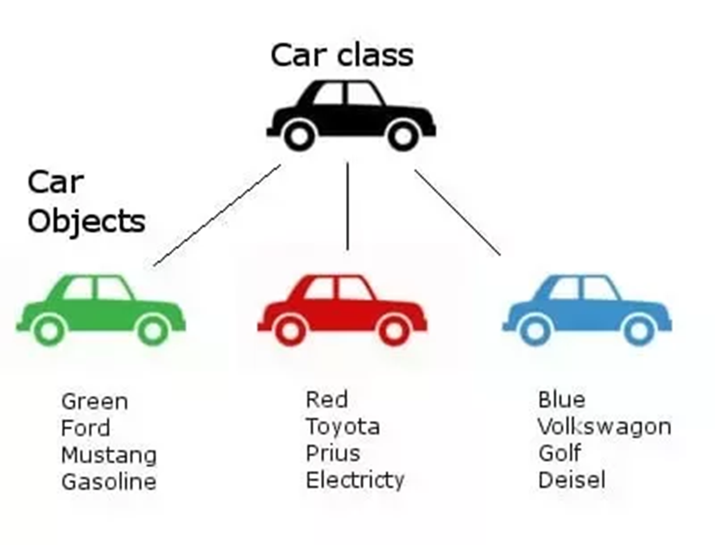
Class and Objects
Car
- Color - Brand
*Display()
Blueprint that describes a car
CLASS
Name
Attributes
Behaviors
Instances of the cars
describe by the blueprint
OBJECT - 1
Prius Car
- Red - Toyota
*Display()
Mustang Car
- Green - Ford
*Display()
OBJECT - 2
OBJECT - 3
Golf Car
- Blue - Volkswagen
*Display()

Slide 12
Next Lecture
Constructor
Non parameterized
Parameterized

Slide 13


